Slide 1
Export Awareness Workshop
EXPORT MARKETING & INVESTMENT ASSISTANCE (EMIA)
Presented By
Mamahlo Letsoalo
Nxalati Mashele

Slide 2
^{DEFINITION}
^{CONTENT}
Definition of EMIA
Objectives of the Scheme
Who qualifies
How do we market SA companies
EMIA Tools
Supporting Documentation
Financial Assistance
Sectors Targeted
How to submit a claim
Conditions
How to contact EMIA/thedtic

Slide 3
^{DEFINITION}
Export Marketing and Investment Assistance ( EMIA) is an incentive offered by the Department of Trade, Industry and Competition to partially compensate exporters for costs incurred in respect of identifying new and developing export markets for SA Products and Services and recruiting Foreign Direct Investment into the country.

Slide 4
^{OBJECTIVES} OF EMIA
Provide marketing assistance in order to develop new export markets and grow existing export markets;
Assist with the identification of new export markets through market research;
Assist companies to increase their competitive by supporting patent registrations;
Assist with facilitation to grow FDI through Investment Missions; and
Increase the contribution of black-owned businesses and SMMEs to South Africa's economy

Slide 5
^{WHO} QUALIFIES FOR EMIA
The following entities qualify to apply for funding:
Registered South African Manufacturers/service companies
South African export trading houses
Commission agents
South African Export Councils
Industry Associations
Joint Action Groups
South African registered co-operatives
All entities should have traded for more than one financial year
Export Readiness - The company and product must be ready for international trading, having the capacity, meet all the requirements in terms of product quality.
Funding will be available for one person per company (representing the company during the event)

Slide 6
^{HOW DO WE MARKET} SA COMPANIES VIA ^{EMIA}
Exhibitions : National Pavilions
Group Trade Missions : Outward Trade Missions
: Outward Investment Missions
: Inward Buying Missions
: Inward Investment Missions

Slide 7
EMIA TOOLS - NATIONAL PAVILLIONS
National Pavilions
the dtic assists South African exporters by organising National Pavilions ( Exhibition show) to showcase local products at international trade exhibitions
Companies participating under National Pavilions has an advantage of group participation at a leading local or International trade fair;
These companies are clustered together according to its sectors or combination of sectors (Multi sector)

Slide 8
^{GROUP} TRADE MISSIONS
Group Outward Selling /Investment Missions
the dtic provides assistance to South African exporters who seek to conclude export orders with foreign buyers and for South African entities which seek to encourage and attract foreign direct investment into the country.
The offerings includes assistance for export/Investment Seminars/Conferences and Primary Market Research Mission
These missions are exclusively organised by Export Councils, Chambers of Commerce, Provincial Investment Promotion Agencies, Metros, Export Clubs or thedti

Slide 9
^{GROUP} TRADE MISSIONS CONTI…
Group Inward Buying/Investment Missions
the dti provides assistance to organisers of inward buying trade missions, which seek to enable the conclusion of export orders between South African exporters and prospective foreign buyers.
the dti provides assistance to organisers of inward investment missions, which seek to facilitate the flow of FDI into South Africa.
These missions are organised by Export Councils, Chambers of Commerce, PIPA’s, Export Clubs or thedti

Slide 10
^{SUPPORTING} DOCUMENTATION
National Pavilions or Group Mission Application forms which are available from the the dtic website: www.thedtic.gov.za
Copy of the company registration documents ( CIPC)
Colour brochure of the company’s products
Digital Images ( for branding)
Copy of audited financial statements/letter from the accounting officer confirming the Assets, Liabilities, Turnover and number of employees
Copy of export registration certificate ( from SARS customs office)
Copy of a passport
Valid SARS Compliance Pin
BEE Certificate

Slide 11
^{FINANCIAL ASSISTANCE}
Export Marketing and Investment Assistance will cover the costs towards the following:
Local and International Travel costs ( airfare) (economy class)
Hotel Accommodation (Subsistence allowance)
Transportation of Exhibition materials ( Freight Forwarding and clearing services)
Exhibition costs relating to stand rental, design and set-up costs for physical/ hybrid and virtual events

Slide 12
^{FINANCIAL} Benefits – Pavilions (Inter)
International Travel Costs
SMMEs ( include BOE, WWOE,BWOE)
Other sized Co’s
Hotel Accommodation
SMMEs ( include BOE, WWOE,BWOE)
Other sized Co’s
Exhibition costs (Physical/Virtual)
SMMEs ( include BOE, WWOE,BWOE)
Other sized Co’s
Freight Forwarding and Clearing Services
SMMEs ( include BOE, WWOE,BWOE)
Other sized Co’s
100% of the total cost to a maximum of R20,000.00
No benefits
R3,500.00 per day
No Benefits
100% of the total cost
100% of the total cost

Slide 13
^{FINANCIAL} Benefits – Pavilions (Local)
International Travel Costs
SMMEs ( include BOE, WWOE,BWOE)
Other sized Co’s
Hotel Accommodation
SMMEs ( include BOE, WWOE,BWOE)
Other sized Co’s
Exhibition costs (Physical/Virtual)
SMMEs ( include BOE, WWOE,BWOE)
Other sized Co’s
Freight Forwarding and Clearing Services
SMMEs ( include BOE, WWOE,BWOE)
Other sized Co’s
100% of the total cost to a maximum of R5,000.00
No benefits
R2,000.00 per day
No Benefits
100% of the total cost
100% of the total cost

Slide 14
^{FINANCIAL} Benefits – Group Missions( Inter)
International Travel Costs
SMMEs ( include BOE, WWOE,BWOE)
Other sized Co’s
Hotel Accommodation
SMMEs ( include BOE, WWOE,BWOE)
Other sized Co’s
Exhibition costs (Physical/Virtual)
SMMEs ( include BOE, WWOE,BWOE)
Other sized Co’s
Group Mission coinciding with an International trade show
Freight Forwarding and Clearing Services
SMMEs ( include BOE, WWOE,BWOE)
Other sized Co’s
Excess Luggage
100% of the total cost to a maximum of R20,000.00
50% of the total cost to a maximum of R10,000.00
R3,500.00 per day
100% of the total cost
100% of the total cost
R2,500.00

Slide 15
^{SECTORS} TARGETED
Aerospace, Rail and Marine
Agro-Processing, including Furniture
Built Environment Professions ( Consulting, Civil, Architecture and Quantity surveys)
Chemicals ( Pharmaceuticals and Plastics fabrication)
Business Process Outsourcing (BPO)
Capital Equipment and Allied services
Automotive
Clothing, textiles, footwear and leather products
Creative industries ( Film and television, music and crafts)
Electro-technical industries ( electronics, electrical engineering)
Energy –efficient products
Metals fabrication
Paper and pulp
Pre-Qualified Tourism
All sectors as outlined in the IPAP

Slide 16
^{HOW TO APPLY FOR EMIA FUNDING}
Applicants to submit applications Five (5) months prior to the event ( National Pavilions) and Two (2 ) months prior for Group Missions
Due to Covid 19 Pandemic all applications must be forwarded to EMIA via e-mail.
Applications to be acknowledged within 48 hours
Complete applications will evaluated and subsequently presented to the Adjudication Committee for approval
The Committee meets twice per month unless there are urgent applications
Successful and unsuccessful applicants will be notified in writing, should the company wish to appeal the outcome of the application, such request must be forwarded to the Director responsible for EMIA.
EMIA reserves the right to decline qualifying entities due to budget constraints.

Slide 17
^{HOW TO SUBMIT} A CLAIM
Claim form together with the following supporting documentation to be e-mailed within three (3) months after the date of return from event : EMIAClaims@thedtic.gov.za
Supporting documentation:
Signed approval letter
Copy of passport showing the personal details
Copy of entry/departure date stamps
COPY OF BOARDING PASSES
COPY OF SARS COMPLIANCE PIN
COPY OF VALID BBBEE CERTIFICATE
Copy of e-ticket if the dtic did not procure ticket
Proof of payment in the form of bank statement
Proof of bank account – Letter from the bank confirming the banking details
Signed Supplier Maintenance Form ( the dtic will provide to clients)
Delay in processing claims will cause by the following:
Banking details verification and SARS verification
ALL CLAIMS WILL BE ACKNOWLEDGED WITHIN 48 HOURS

Slide 18
^{CONDITIONS}
Applicants must submit a report six (6) month after the event, failure to do so the company will be excluded from accessing further assistance for a period of two years
Site visit will be conducted by the dtic to confirm the existence of the company or to verify the information submitted during application stage

Slide 19
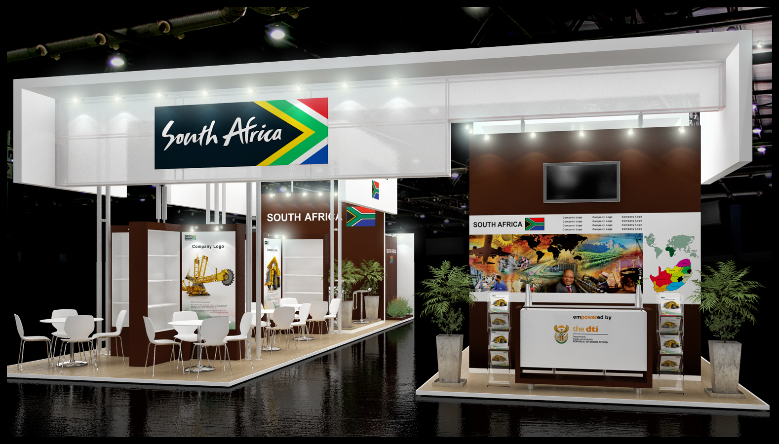
^{NATIONAL PAVILLIONS STAND}

Slide 20
EMIA CONTACTS
^{CONTACT DETAILS}
Deputy Director: Individual Participation | Busisiwe Radebe | BRadebe@thedtic.gov.za | 012 394 1038
Director | Ernest Moagi | emoagi@thedtic.gov.za | 012 394 1961
Deputy Director: Group Missions | Allison Christian /Corne du Plessis | achristian@thedtic.gov.za/ cduplessis@thedtic.gov.za | 012 394 1028 012 394 1020
Deputy Director: National Pavilions Deputy Director: EMIA Claims and Performance Measurements | Samuel Maboane/ Victor Makhele Nxalati Mashele | smaboane@thedtic.gov.za vmakhele@thedtic.gov.za Nmashele@thedtic.gov.za | 012 394 1357 012 394 1034 012 394 1146

